Slide 1
TRAFFIC RIDER
REINFORCEMENT LEARNING
Done By:
CHITTOOR KARTHIK – 106121033
P VISHNU VARDHAN - 106121089

Slide 2
AIM
The aim of this project is to develop an intelligent agent capable of outperforming human players in a specific task, leveraging reinforcement learning as a practical application. By implementing a reinforcement learning algorithm, the project seeks to train the agent to make optimal decisions in a dynamic environment, with the ultimate goal of achieving superior performance compared to human players. Through the iterative process of learning from its actions and experiences, the agent adapts its behavior to maximize cumulative rewards, thereby mastering the task at hand. This project not only demonstrates the potential of reinforcement learning in real-world scenarios but also highlights its ability to enhance decision-making processes beyond human capabilities, paving the way for the development of autonomous systems capable of tackling complex tasks efficiently and effectively.

Slide 3
01
02
03
GAME CREATION
Q-Learning Implementation
TRAINING the agent
The initial traffic-rider game is created using pygame in python
Implementation of agent choosing actions on its own using Q-Table
Train the agent until desired convergence

Slide 4
GAME CREATION
01
Building an Interactive Car Dodging Game

Slide 5
TRAFFIC RIDER
Traffic Rider is a 2D game in which the user has to dodge the fore coming traffic at each stage.
The user can control the car using LEFT and RIGHT arrow keys on the keyboard.
The user scores points for every vehicle successfully dodged.
At each level the speed of the traffic increases thereby increasing the difficulty.
The game ends after the user hits an obstacle or crosses the road border.

Slide 6
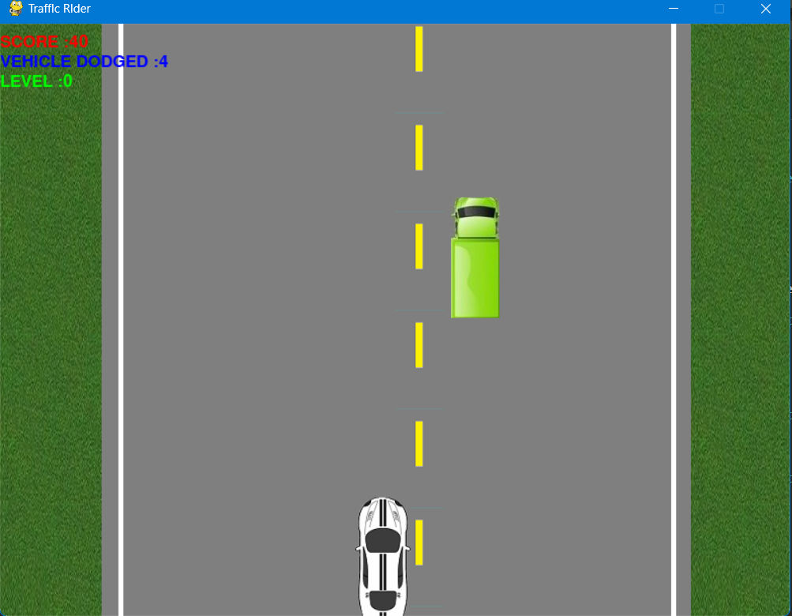
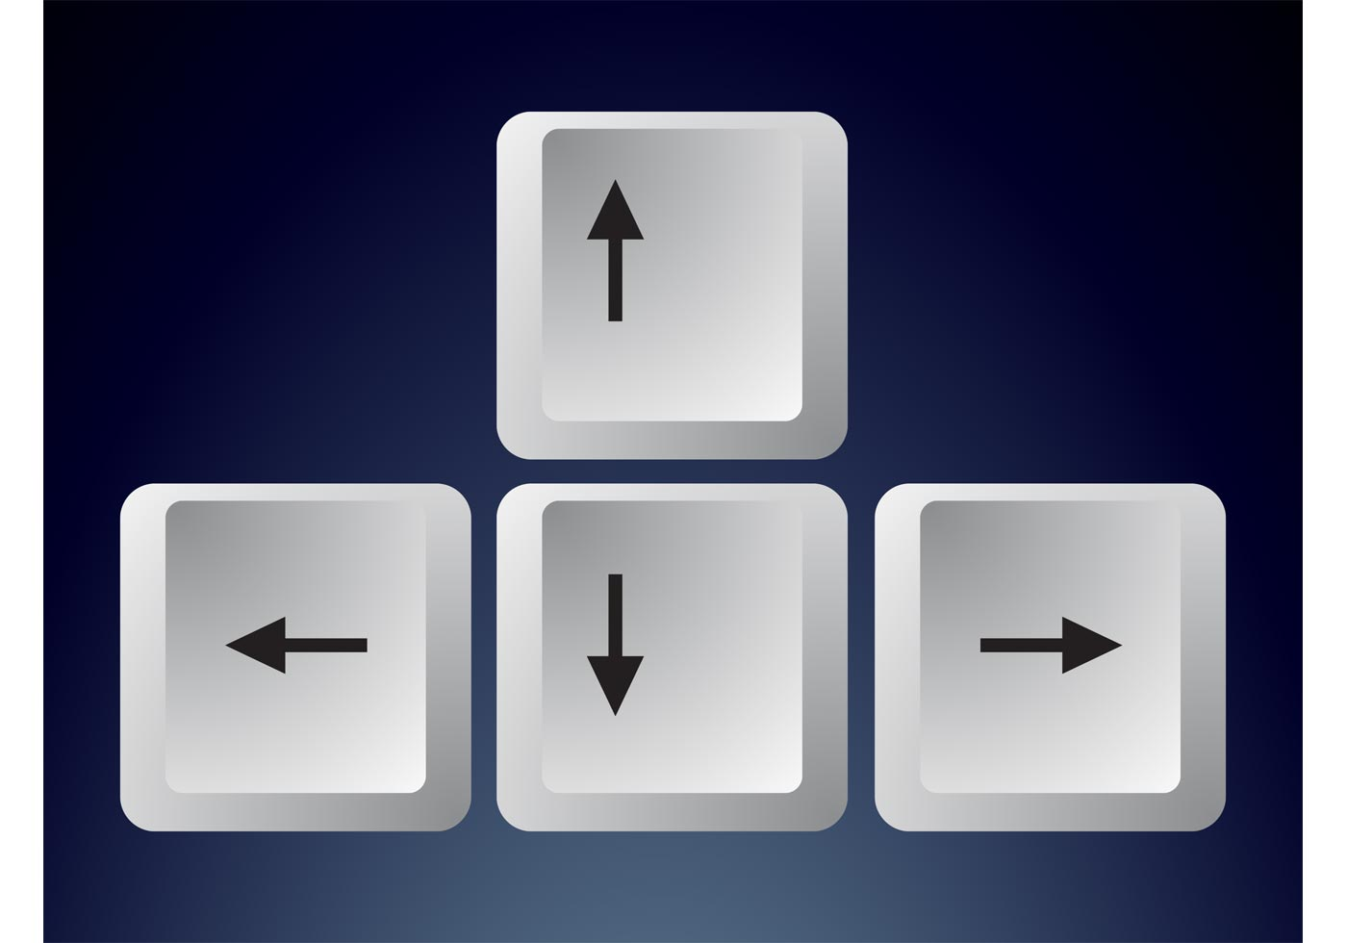



USER CONTROLS

Slide 7
Q-Learning Implementation
02
Making the agent play on its own

Slide 8
Understanding the game environment
Define the states and actions
State Reduction
Q-Table
Define how the agent interacts with the game environment
Space efficiency
Decide which transition is best at each state

Slide 9

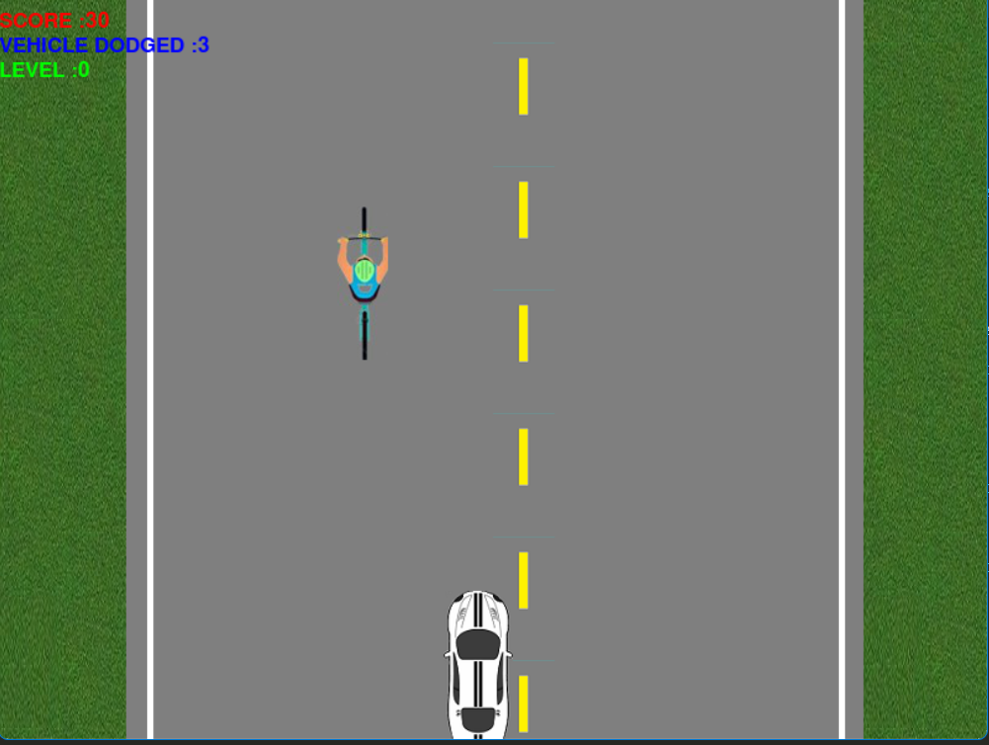








Defining the STATES and ACTIONS
STATE: (car x,car y,obstacle x,obstacle y)
Transitions: go Left,
go Right,
Stay

Slide 10
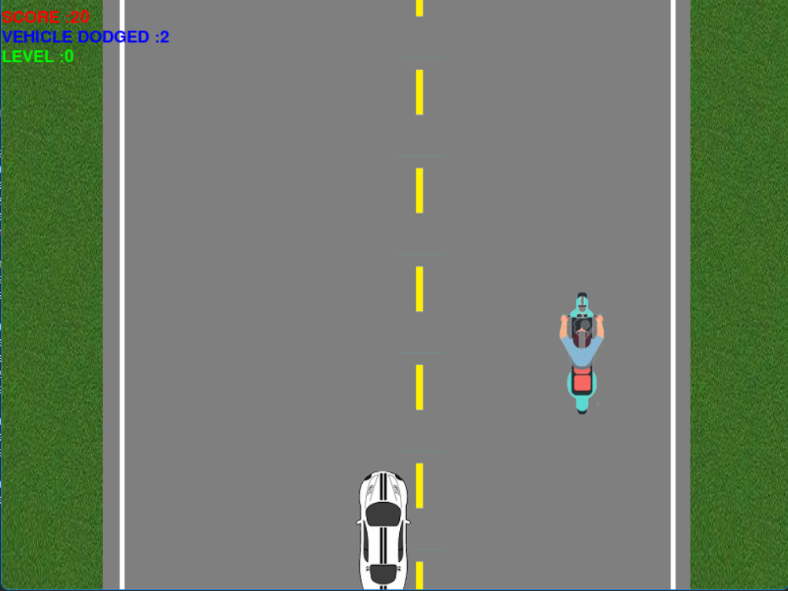















STATE REDUCTION and DISCRETIZATION
Reduced State: (Car X-coordinate, Obstacle X-coordinate)
Round off Co-ordinates for discretizing the state space

Slide 11
Q-TABLE
STATE and ACTION | Go Left | Go Right | Stay
(35,165) | 823.75 | -7431 | -632
(42,178) | 10089 | 1023 | 0
(72,81) | 10000 | 10000 | -9823
Choose action with maximum reward

Slide 12
Train the agent
03
Till desired performance and convergence of the Q-table values

Slide 13






TRAINING the Agent
Use this Q-table
Fetch Trained Data
Q-TABLE
Trained Data File
Upload this
Trained Data
Update this Q-table
Agent playing

